Slide 1

AIRLINE RESERVATION SYSTEM
CENTRE FOR DEVELOPMENT OF ADVANCED COMPUTING, NEW DELHI
Under the guidance of
Mr. Zeeshan Ahmad Khan
PG DAC (Sept 2022) Group-15
Chetan Nagmoti (220910120013)
Bhavesh Gupta (220910120009)
Mayuresh Kate (220910120029)
Sudeep Suryawanshi (220910120049)

Slide 2
Introduction
The airline reservation system project aims to create a platform for passengers to book and manage their flights online. The system will provide a user-friendly interface for customers to search for flights, view schedules, and make reservations. It will also enable them to manage their bookings, including changing or cancelling flights.
Overall, the airline reservation system project will streamline the booking process for customers and airlines, making it more efficient and convenient for all parties involved

Slide 3
Purpose
An airline reservation system project is an essential tool for any airline company that seeks to enhance their customer experience, streamline their operations, and improve their overall efficiency. By providing an online platform for customers to make reservations, purchase tickets, and select their preferred seating, the airline reservation system enables airlines to provide a convenient and user-friendly experience to their customers. This, in turn, can help attract more customers and increase revenue for the airline.

Slide 4
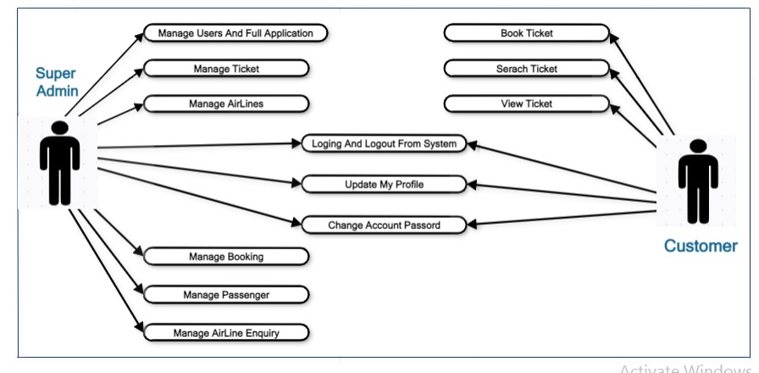
Use Case Diagram-

Slide 5
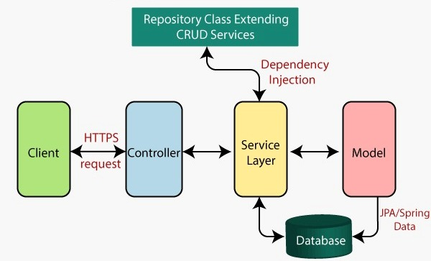
Architectural View

Slide 6
MODULES
Customer Module
Login and Registration
Search Flight
Book Flight
Add passenger page
Booking Summary page
Booking History Page
Make Payment Page
Print ticket page

Slide 7
Administrative Modules
Admin Home Page
Admin Login Page
Admin can add flights
Admin can update add flights
Available flight list page

Slide 8
Technology
Front End: Html 5,Css 3 ,Bootstrap 5,React JS 17, Axios
Back End : Spring boot , Maven ,Hibernate
Database : MYSQL 8.0
IDE : Eclipse 2022, VS Code

Slide 9
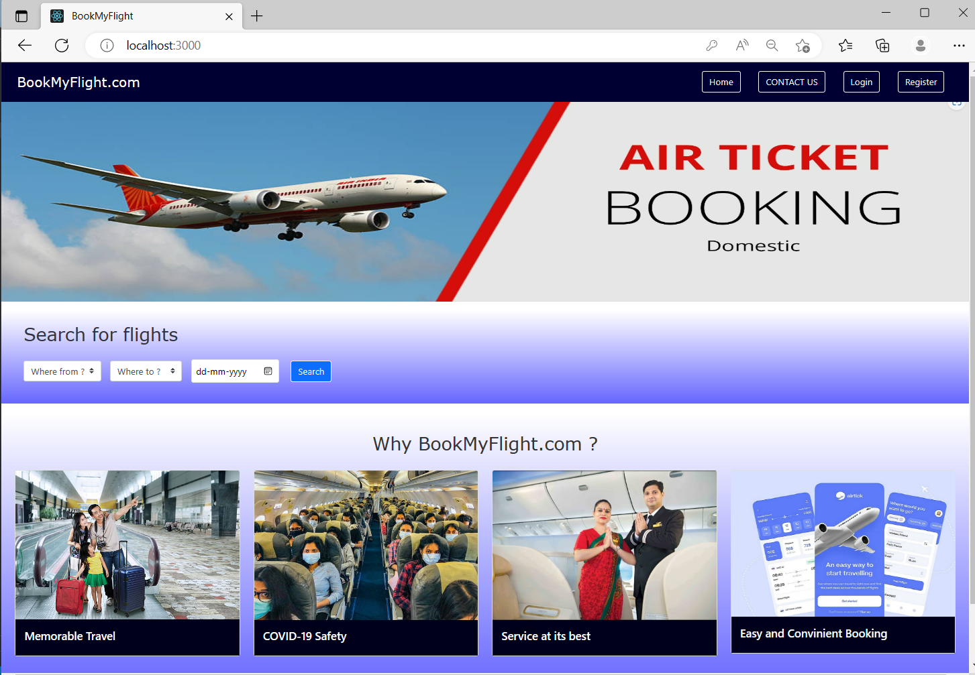
Home page

Slide 10
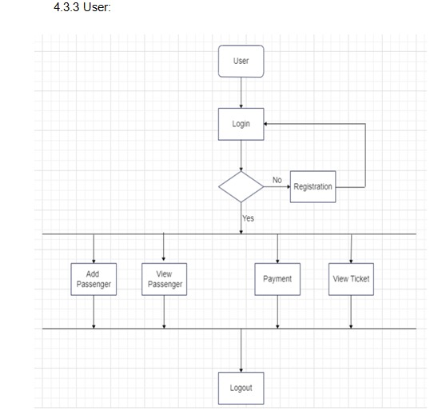
User Flow Chart

Slide 11
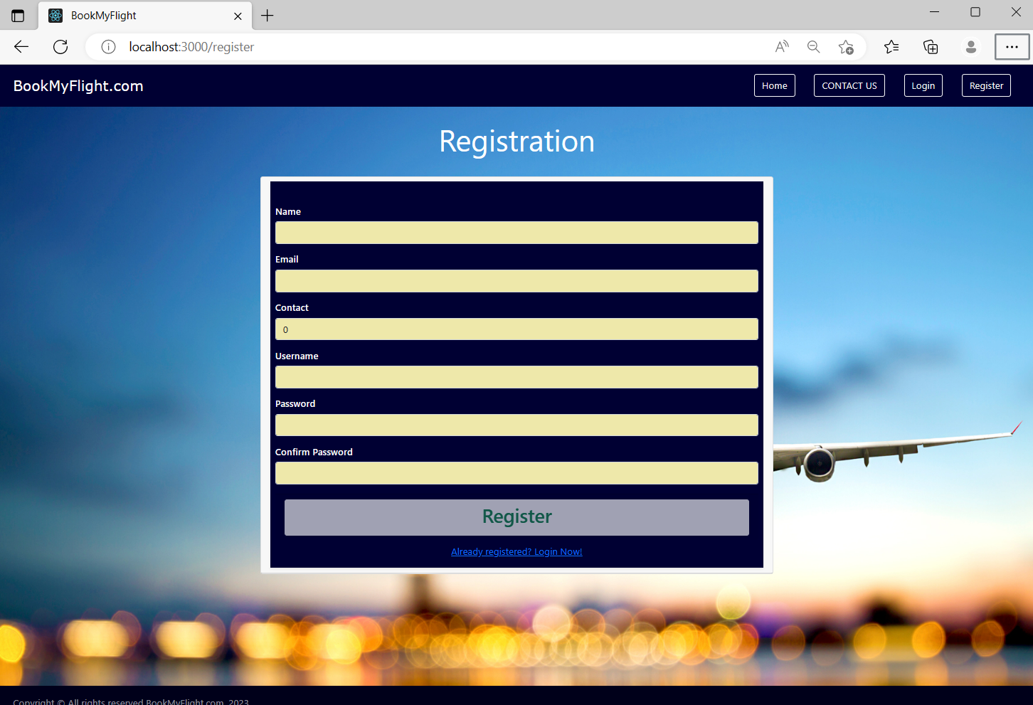
Register

Slide 12
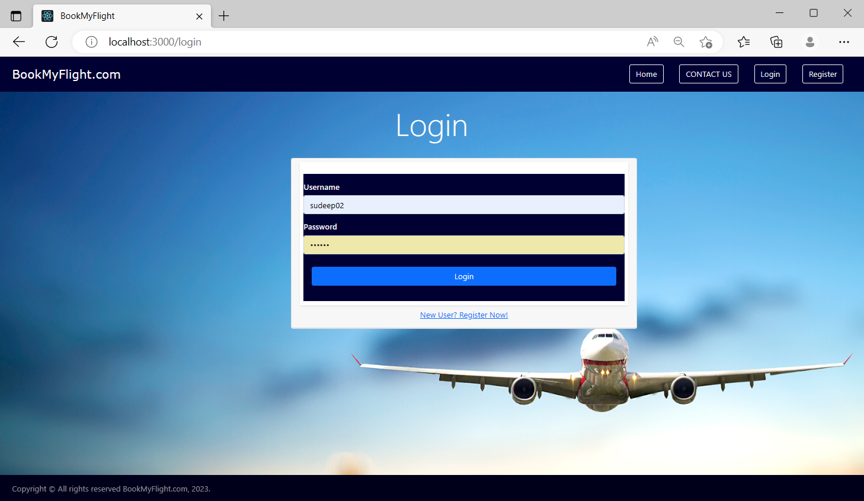
Login

Slide 13
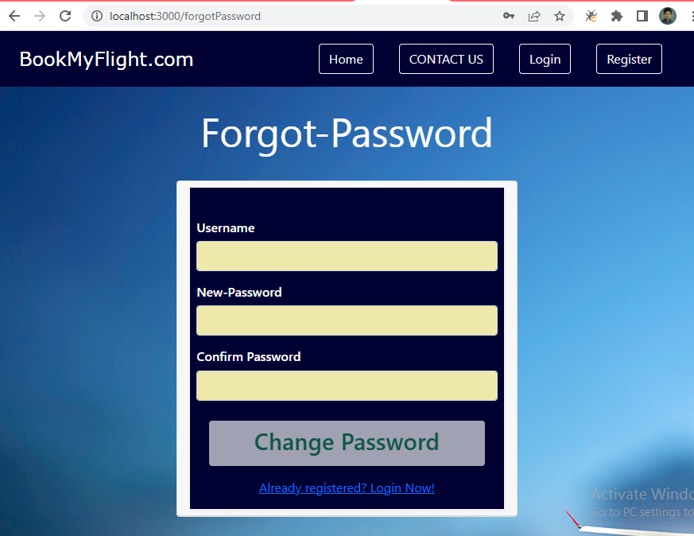
Forgot Password

Slide 14
Login

Slide 15
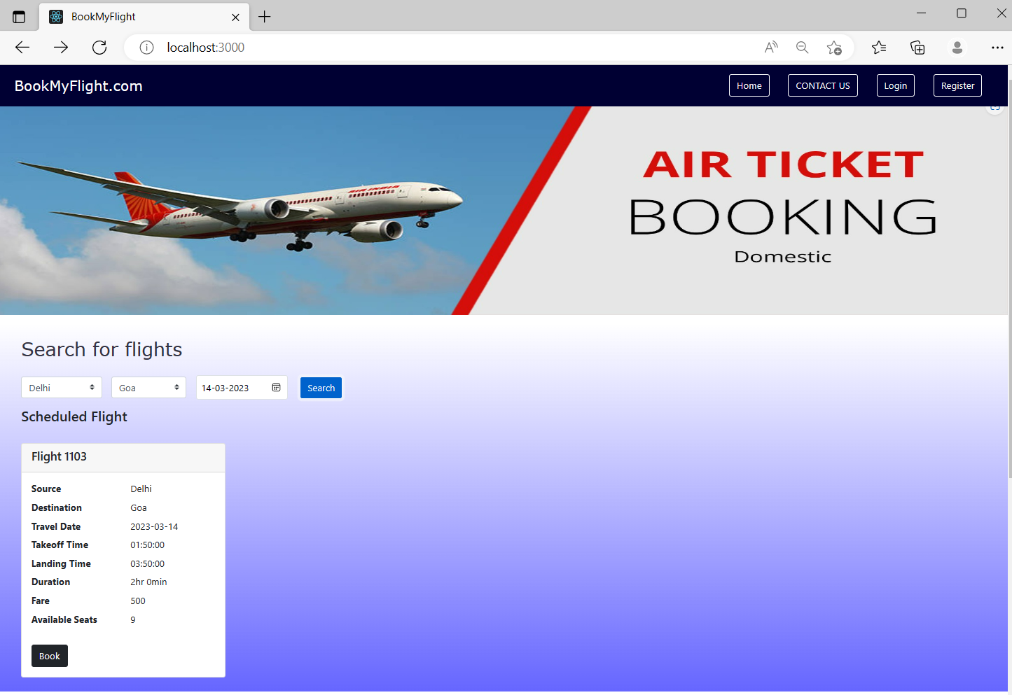
Search Flight

Slide 16
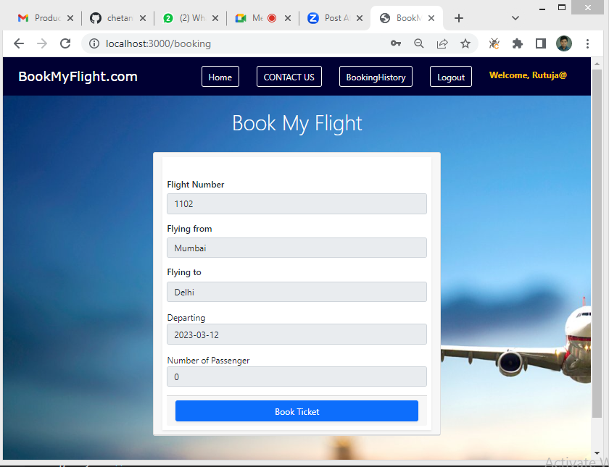
After Book

Slide 17
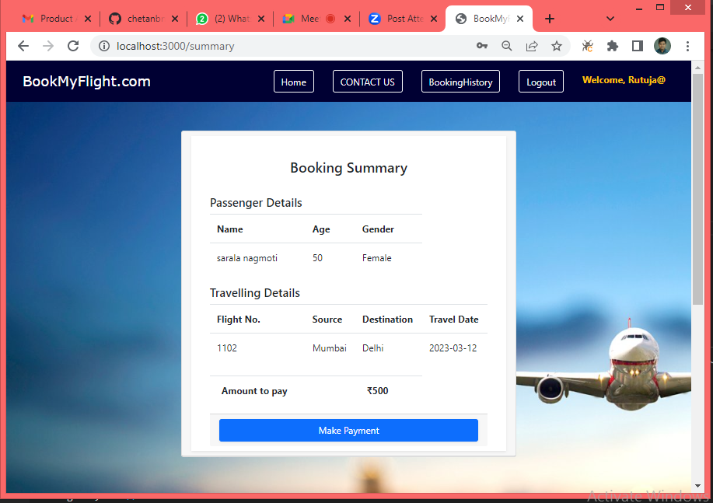
Booking Summary

Slide 18
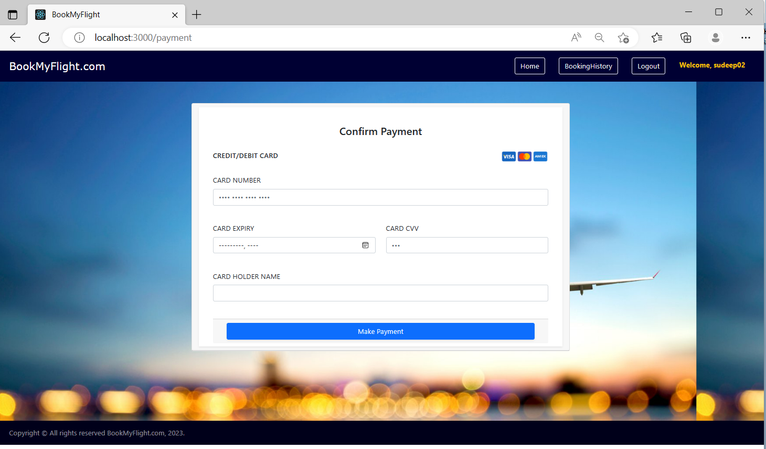
Payment

Slide 19
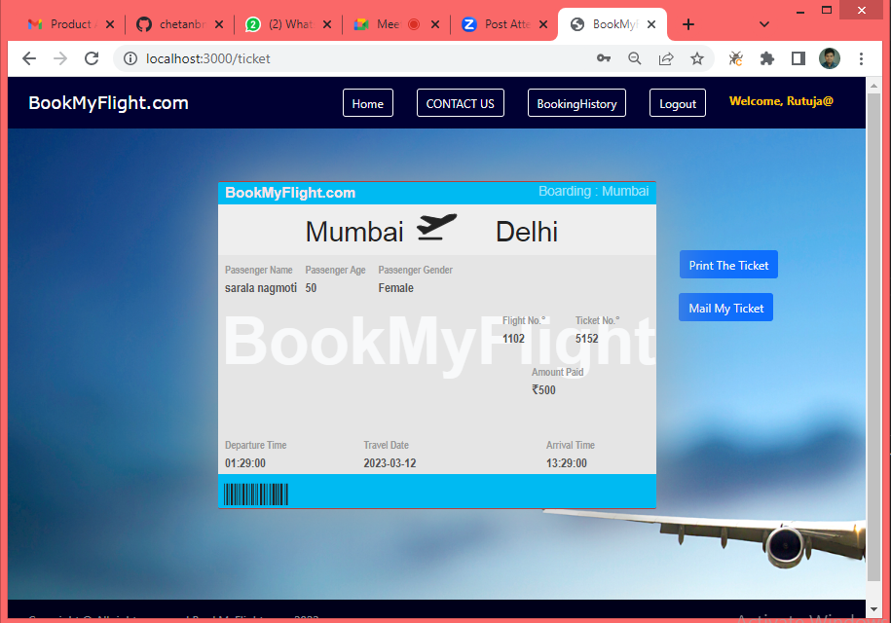
Ticket Generated

Slide 20
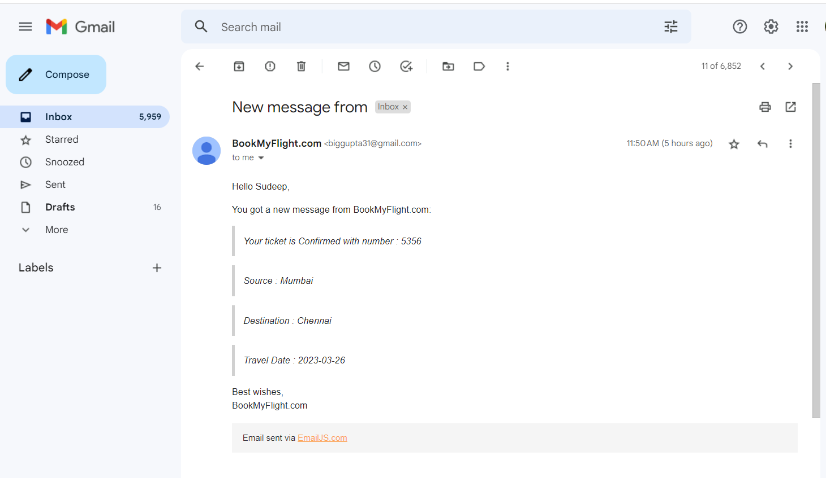
Successful Ticket Mail

Slide 21
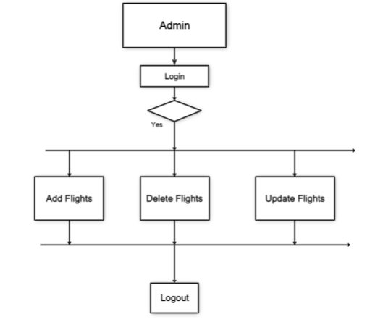
Admin Flow Chart

Slide 22
Admin - Home

Slide 23
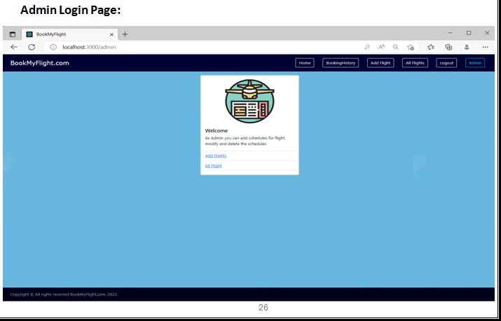
Admin – Login

Slide 24
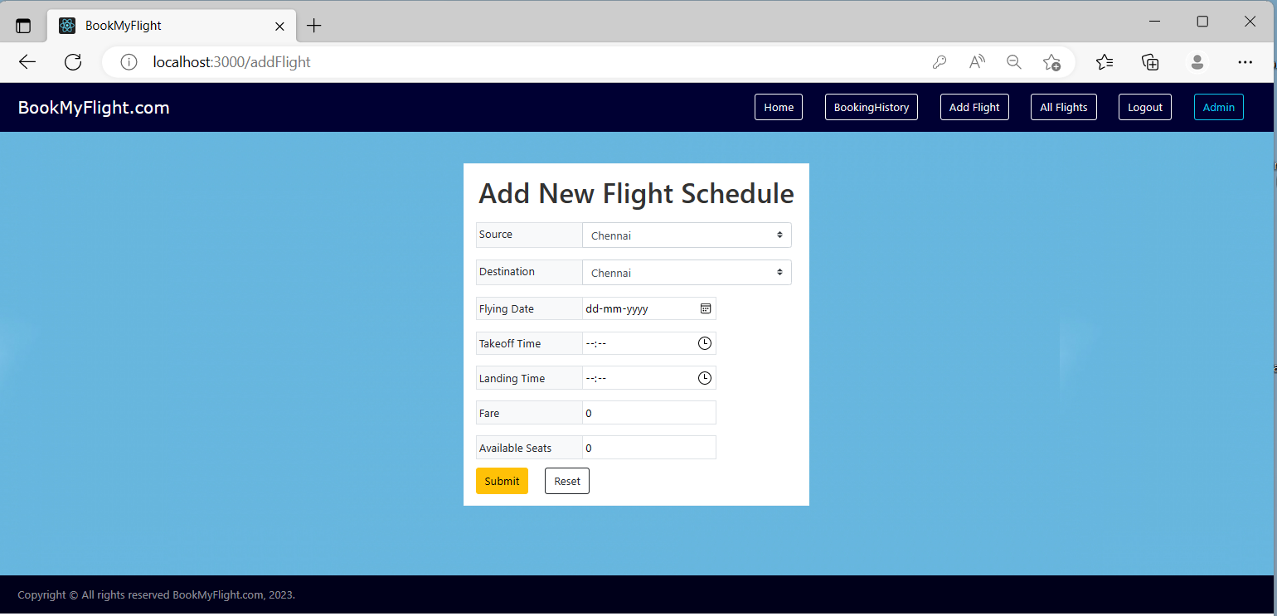
Add Flight

Slide 25
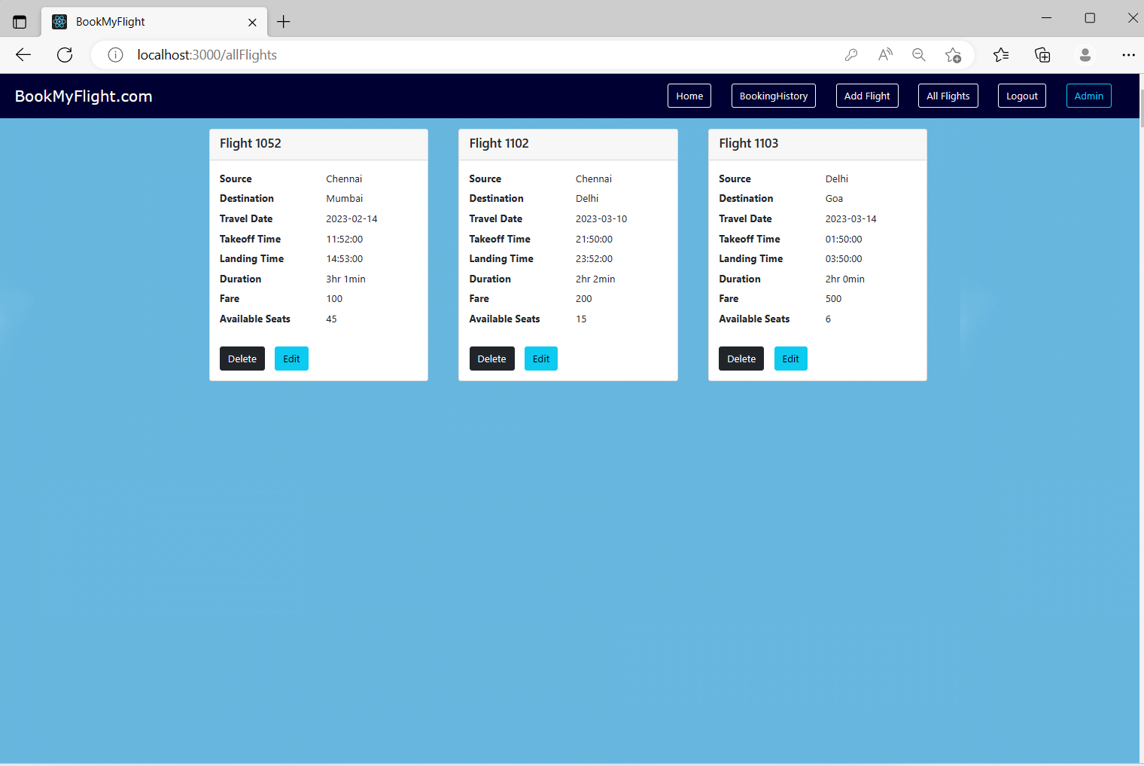
Display List of Flights

Slide 26
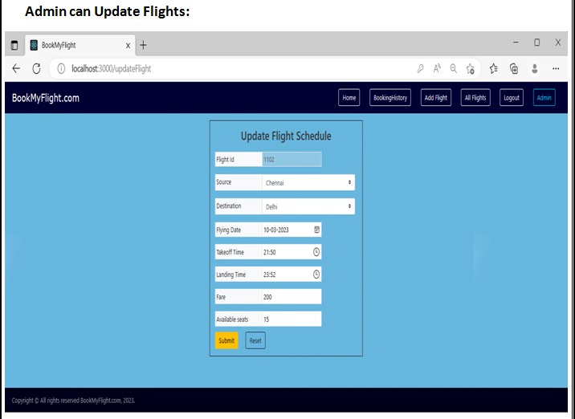
Admin can Update Flight

Slide 27
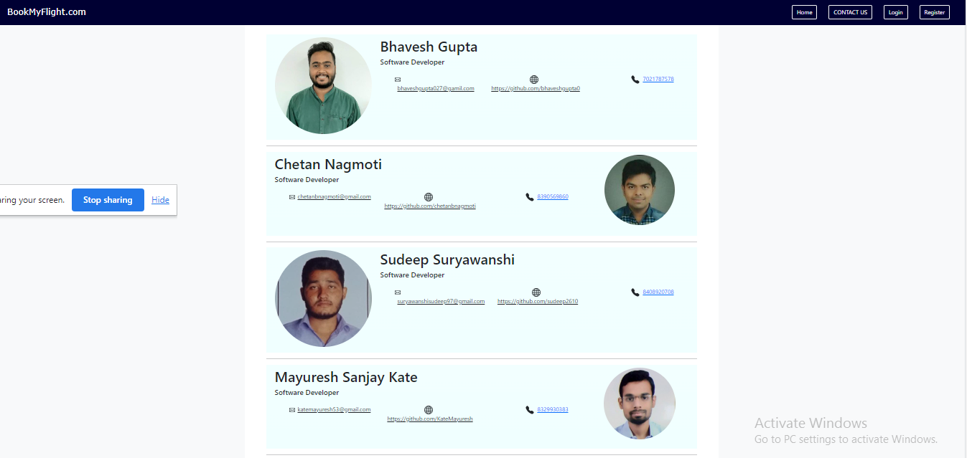
Contact-Us-Page

Slide 28
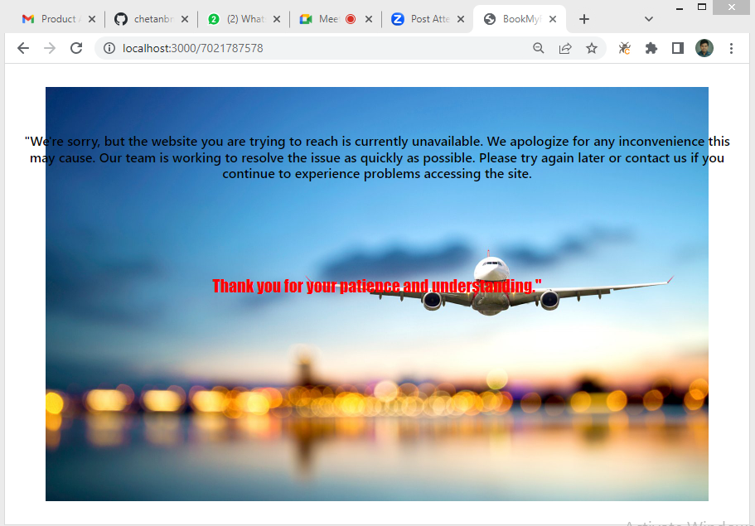
Error Page

Slide 29
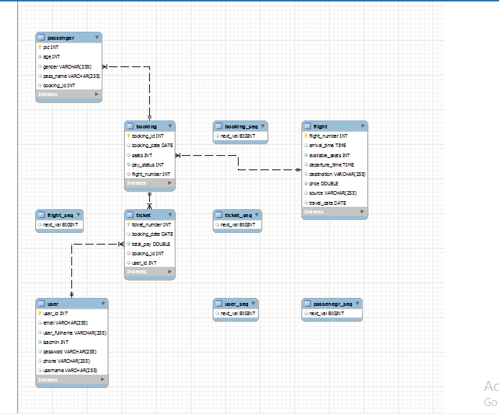
ER - Diagram

Slide 30
Features
User Registration
Flight Search
Booking:.
Payment Gateway:
Reservation Confirmation

Slide 31
Conclusion
In conclusion, an airline reservation system is a crucial software application that allows customers to book and manage their flight tickets easily.

Slide 32
Thank You

